Slide 1



Welcome to the Club!
Automate Admin program kick-off

Slide 2
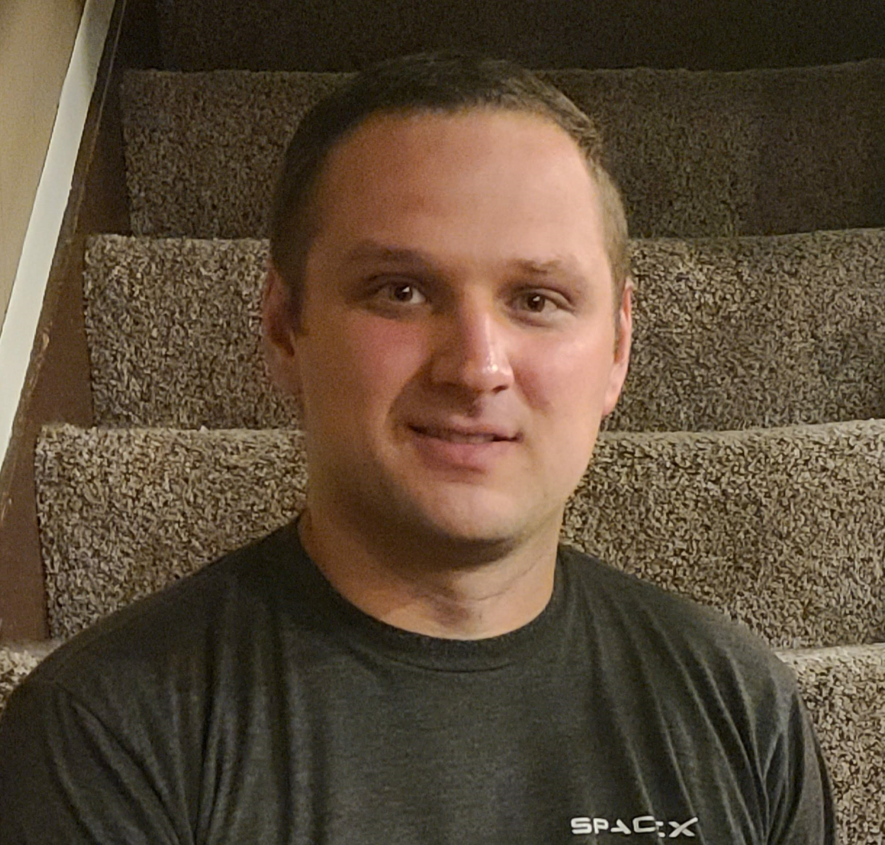
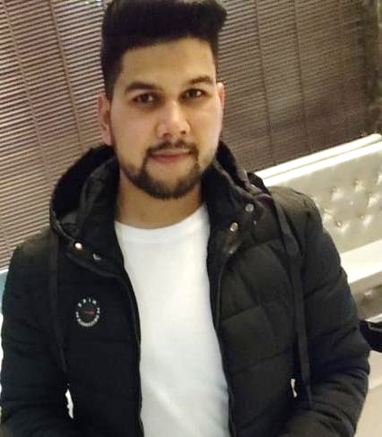
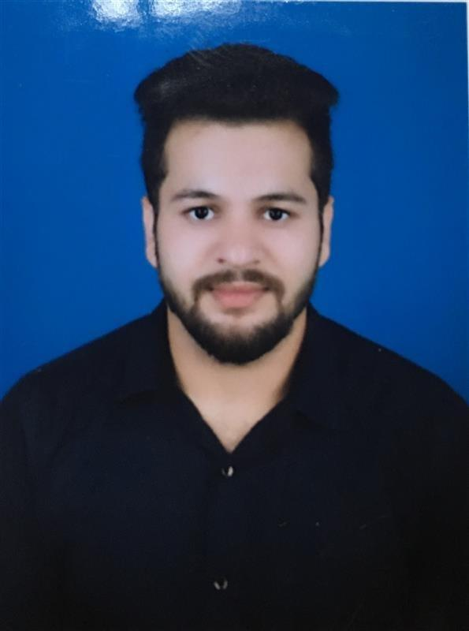
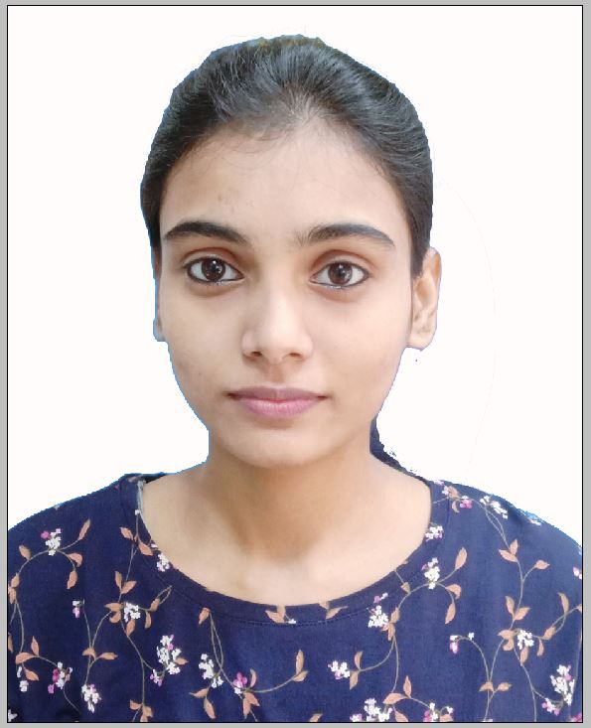


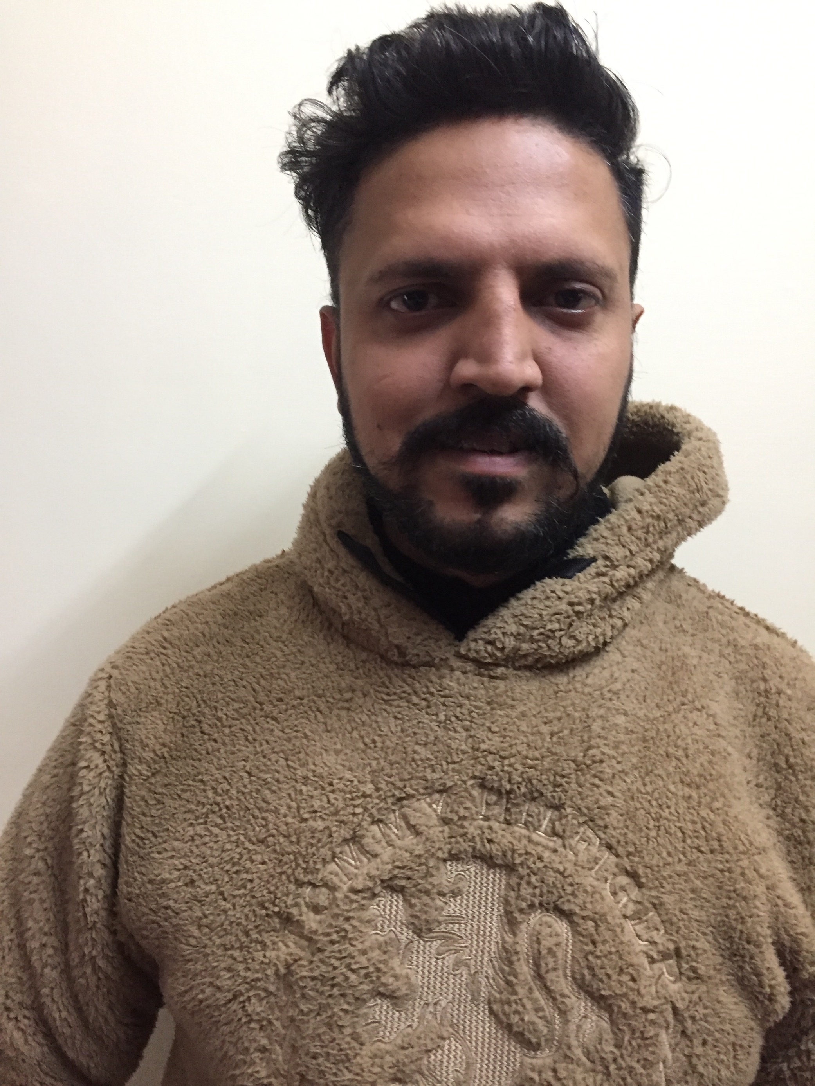

WHO WE ARE AND WHAT WE DO
CONSULTING AND SUPPORT TEAM
Stephen Nix
Automate Engineer & Dev Ops
Alex Ramsbey
MSP Consultant
Ryan Mueller
MSP Consultant
Mir Shahid
Systems Engineer
Amit Pandey
Systems Engineer
Rajni Singh
Systems Engineer
No Photo
Chase Murphy
Service Delivery Manager
Chris Mitchell
MSP Consultant
Kamaldeep Kaur
Systems Engineer
Ram Kishor
Systems Engineer
Sawar Arora
Systems Engineer
Raghav Nayyar
Systems Engineer

Slide 3
ONBOARDING SCHEDULE
TYPICALLY 4-6 WEEKS
Stage 1
Server/Database Review
Automate and Control Application Configuration Review
Templates & branding review
Scheduled scripts review
Plugins review
Best practice plugins discussion
Patch Configuration review
Anti Virus review
Week 1 Review call
Stage 2
Complete Action Items Defined in Week 1 Review Call
Begin Environment Review
Ignite Configuration
Agents
Bad/Old data
PSA integration
Ticket categorization discussion
Ignite Manager Review and discussion
Week 2 Review call
Stage 3
Complete Action Items Defined in Week 2 Review Call
Best practice internal and remote monitoring review
Including service plan based Custom ProVal monitor discussions
Offline server monitoring
Non-best practice monitor review
Custom ProVal add in monitors
Network Probe Review
Virtualization manager monitoring
Week 3 Review Call
Stage 4
Finish all action items from prior weeks
Schedule Staff Training
Schedule Monthly Admin Meeting
Final Review Call
Notes:
Make sure that you review what each section covers:
Stage 1: Covers the Automate Application
Stage 2: Covers Old data and service plan/Ignite Setup
Stage 3: Covers Monitors and Automation review
Stage 4: At this point we start wrapping up the project and moving into your monthly Administration.

Slide 4
ENGAGING PROVAL
Do you like talking to us on the phone?
Email support@provaltech.com
Ask for a callback, leave your direct line and the next available consultant will give you a call.
What if you just aren’t sure?
Just email support@provaltech.com …. We’ll figure it out for you.
There’s only one thing we ask
Try not to email our consultant’s directly, they live and breath tickets. ☺
Have a billing issue or questions?
Email billing@provaltech.com
Need to submit a support request?
Email support@provaltech.com
What about big scary issues?
Email support@provaltech.com
Be sure to include the work “Urgent” or “Emergency” in the subject line.

Slide 5
CREDENTIALING
All credentials are stored in our secure LastPass Vault.
The vault is locked down to only ProVal IP addressing
ProVal will lock ALL accounts under 2FA immediately after logging in.
ProVal will change the password after logging in and setting up 2FA
SSO
If SSO is already configured for the MSP then we only need a login to the CW Home Portal.
ConnectWise Automate
Application
FQDN
Username (PRONOC)
Password
Server (On Prem Only)
Server name
Username (DOMAIN\PRONOC) Password
ConnectWise Control
Application
FQDN
Username (PRONOC)
Password
Server (On Prem Only)
Server name
Username (DOMAIN\PRONOC) Password
ConnectWise Support
Email address @ domain
Username: (PRONOC@domain.com)
Password
Please forward all emails to support@provaltech.com
University.connectwise.com
Add to my Company Contacts
Admin (or at least one with users)

Slide 6
QUESTIONS?
Ask us anything!

